Slide 1

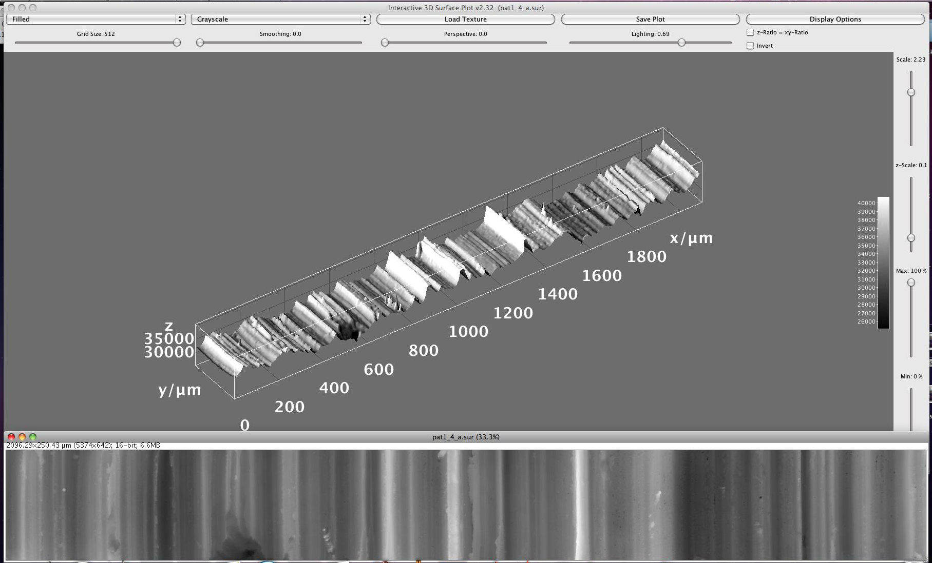

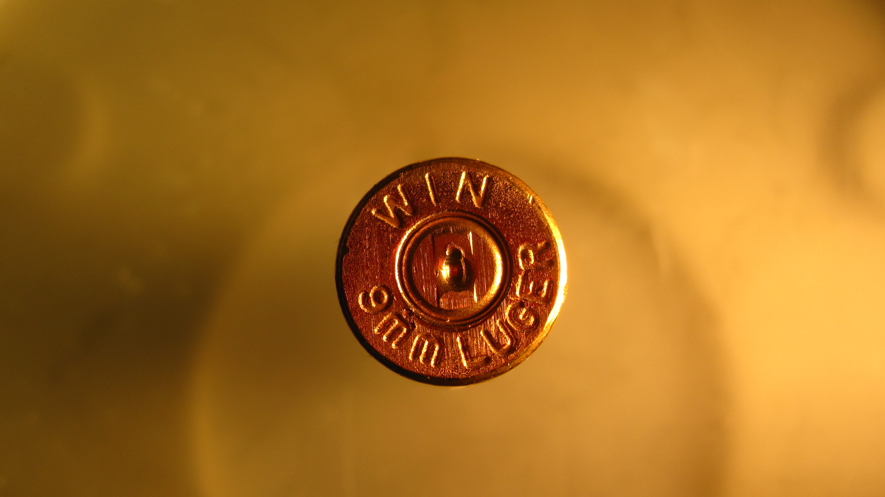
Hands-on Introduction to R

Slide 2
Outline
Mean, median, standard deviation, standard error of the mean
Confidence intervals
Hypothesis testing
Analysis of variance
Linear regression

Slide 3
Measures of Central Tendency
Given a sample from some population:
What is a good “summary” value which well describes the sample and uncertainty?
We will look at:
Average (arithmetic mean)
Median
Mode
Standard deviation
Standard error of the mean
For reference see (available on-line):
“The Dynamic Character of Disguised Behaviour for Text-based, Mixed and Stylized Signatures”
LA Mohammed, B Found, M Caligiuri and D Rogers
J Forensic Sci 56(1),S136-S141 (2011)

Slide 4
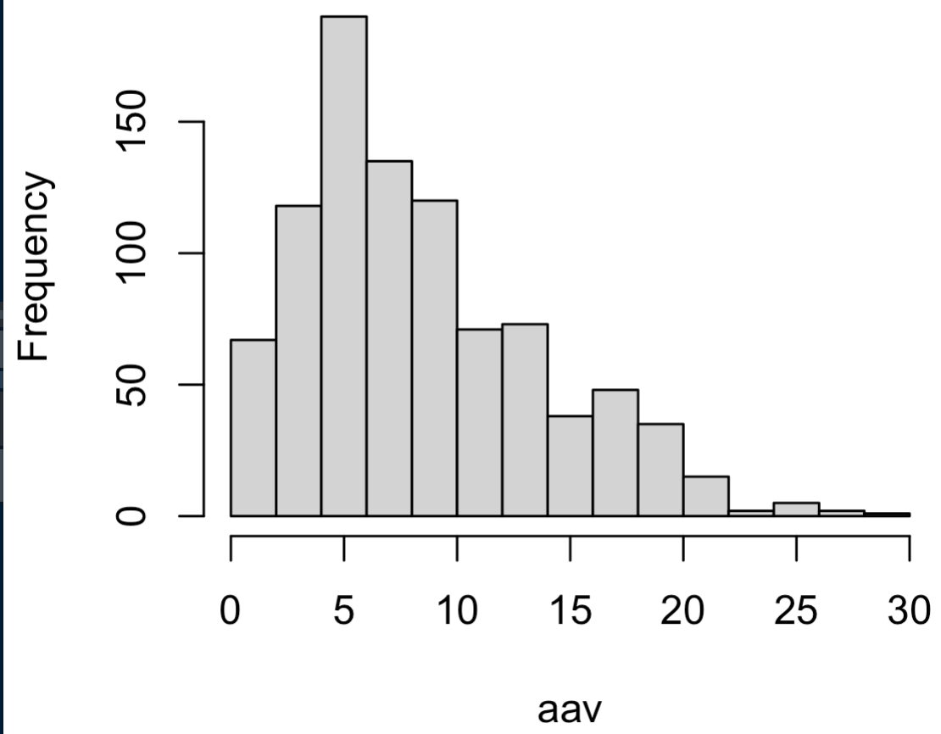
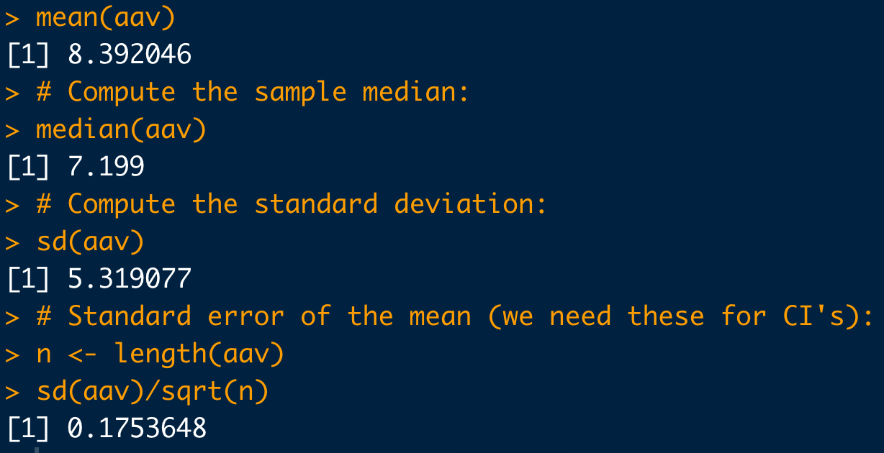
Basic Statistical Commands:
# Load data:
dat <- read.csv("https://raw.githubusercontent.com/npetraco/workshop21/master/data/lamwrite.csv", header=T)
head(dat)
dim(dat)
# Dump column 2 to a variable:
aav <- dat[,2]
# Look at the data:
hist(aav)
# Compute the sample mean:
mean(aav)
# Compute the sample median:
median(aav)
# Compute the standard deviation:
sd(aav)
# Standard error of the mean (we need these for CI's):
n <- length(aav)
sd(aav)/sqrt(n)

Slide 5
Confidence Intervals
A confidence interval (CI) gives a range in which a true population parameter may be found.
Specifically, (1- α)×100% CIs for a parameter, constructed from a random sample (of a given sample size), will contain the true value of the parameter approximately (1- α)×100% of the time.

Slide 6
Confidence Intervals
Construction of a CI for a mean depends on:
Sample size n
Standard error for means
Level of confidence 1-α
α is significance level
Use α to compute t_{c}-value, the critical t-statistic
(1-α)×100% two-sided CI for population mean using a sample average and standard error is:

Slide 7
Confidence Intervals
Compute the 95% confidence interval for the mean average absolute velocity in the LAM data
# Load data:
dat <- read.csv("https://raw.githubusercontent.com/npetraco/workshop21/master/data/lamwrite.csv", header=T)
# Average absolute velocity data:
aav <- dat[,2]
n <- length(aav) # sample size
xbar <- mean(aav) # sample mean
se <- sd(aav)/sqrt(n) # standard error of the sample mean
conf <- 0.95 # level of confidence
alpha <- 1 - conf # level of significance
tc <- qt(1 -alpha/2, df = n-1) # tc for a two-sided CI
xbar.lo <- xbar - tc*se
xbar.hi <- xbar + tc*se
c(xbar.lo, xbar.hi) # Condifence interval for the mean

Slide 8
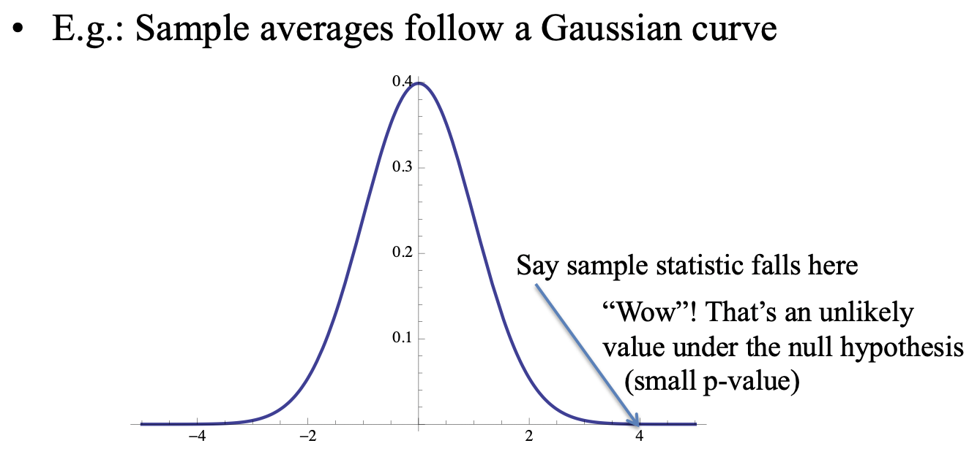
Hypothesis Testing
A hypothesis is an assumption about a statistic.
Form a hypothesis about the statistic
H₀, the null hypothesis
Identify the alternative hypothesis, H_{a}
“Accept” H₀ or “Reject” H₀ in favour of H_{a} at a certain confidence level (1-α)×100%
Technically, “Accept” means “Do not reject”

Slide 9
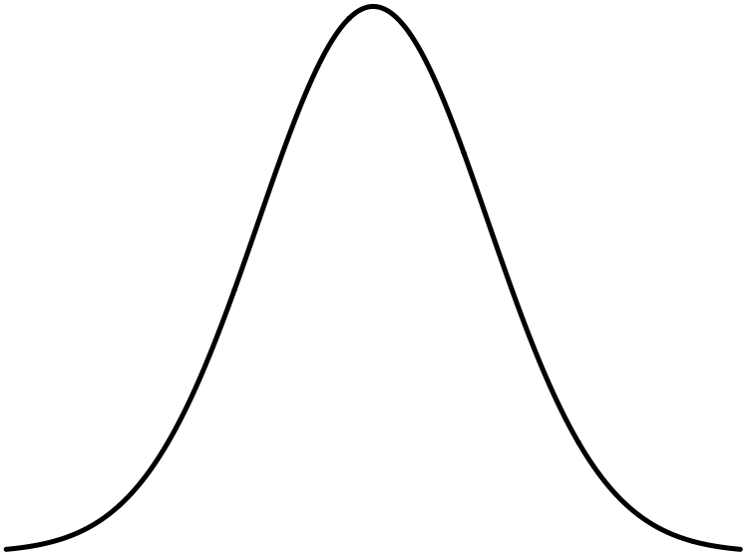
Hypothesis Testing
Sampling distribution for
The “Null distribution”
p-value is this area.
If p-value is > α, it’s “big”: Don’t reject H₀
It’s “big”, so is “likely” if the Null is true
If p-value is < α, it’s “small”: Reject H₀ in favor of H_{a}
p-value is this area.
It’s “small”, so is “unlikely” if the Null is true.
Get a data set and compute . It falls here.
Get a data set and compute . It falls here.
We will use t.test() to take care of the whole process of getting p-values

Slide 10
Hypothesis Testing
Hypothesis testing can go wrong:
1-β is called test’s power
Power analysis: can help to estimate required sample sizes
Get’s very complicated very quickly however…
 | H₀ is really true | H₀ is really false
Test rejects H₀ | Type I error. Probability is α | OK
Test accepts H₀ | OK | Type II error. Probability is β

Slide 11
Example: Two Sample Hypothesis Testing for the Mean
Could the two sets of glass shards be from the same window?
RIs # 1: 1.53419 1.53275 1.53345 1.53267 1.53292 1.53332 1.53464 1.53299 1.53430 1.53550
RIs # 2: 1.53577 1.53606 1.53602 1.53544 1.53618 1.53604 1.53551 1.53572 1.53580 1.53567
Do a two sample 95% confidence hypothesis test to test if : μ_{RI #1} ≠ μ_{RI #2} (H_{a}).

Slide 12
Example: Two Sample Hypothesis Testing for equivalence of Means
# Question of interest: Could the two sets of glass shards be from the same window ?
# NULL HYPOTHESIS: RI1 == RI2
# ALTERNATIVE HYPOTHESIS: RI1 != RI2
# RIs of shards from glass pane 1
RI1 <- c(1.53419, 1.53275, 1.53345, 1.53267, 1.53292, 1.53332, 1.53464, 1.53299, 1.53430, 1.53550)
# RIs of shards from glass pane 2
RI2 <- c(1.53577, 1.53606, 1.53602, 1.53544, 1.53618, 1.53604, 1.53551, 1.53572, 1.53580, 1.53567)
# It helps to look at a box-and-whiskers plot for two-sample tests:
boxplot(RI1, RI2)
# *Check to see if (H0) variances of the two samples equal = 1 (i.e. evidence that vars are not equal??):
var.test(RI1, RI2)
# Two sample two sided hypothesis test for equivalence between means:
t.test(RI1, RI2, var.equal = FALSE, alternative = "two.sided", conf.level = 0.95)
Η₀: μ_{RI #1} = μ_{RI #2}
Η_{a}: μ_{RI #1} ≠ μ_{RI #2}

Slide 13
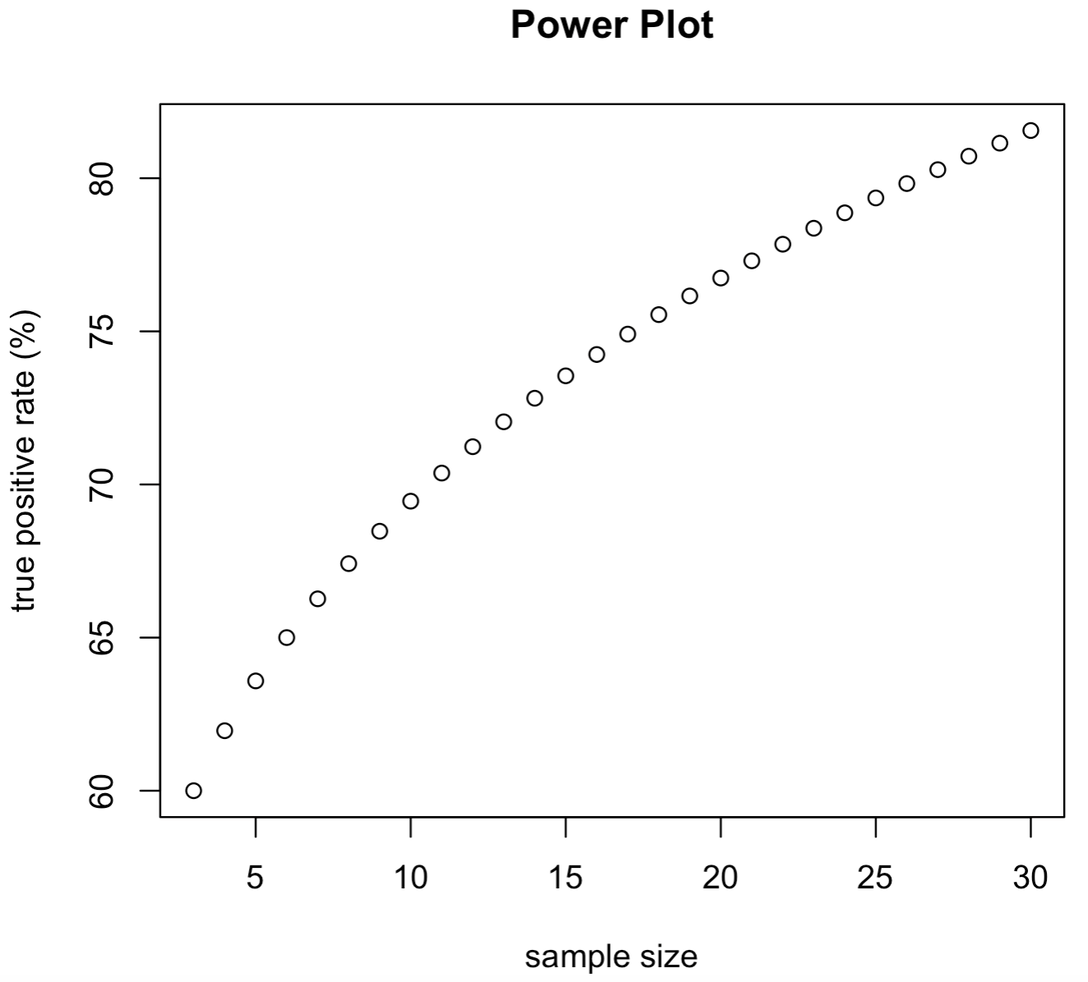
Example: Simple two sample power analysis
It’s hypothesised that the amount of touch DNA collected from the unwashed index finger of males vs. females differs. It’s known that the amount of deposited touch DNA is very variable and the standard deviation for a series of DNA quants hovers around 3 units per person. If on average, the smallest detectable difference of interest is 0.5 units, given there really is a difference, compute a power analysis curve to give the probability of detecting this difference (true positive rate, test power). Use sample sizes from n = 3 to n =100.
# Input parameters
dif.guess <- 0.5 # Minimum mean difference of interest
sd.dif.guess <- 3.0 # Guessed measurement uncertainty
# Power plot for sample
n <- seq(3, 30) # sample sizes
se.guess <- sd.dif.guess/sqrt(n) # standard error per sample size
tc.guess <- dif.guess/se.guess # t-statistic for each sample size
# Sample size vs. power plot
plot(n, pt(tc.guess, n-1)*100,
xlab="sample size",
ylab ="true positive rate (%)",
main="Power Plot")
# Sample size table
cbind(n, pt(tc.guess, n-1)*100)

Slide 14
Analysis of Variance
Standard hypothesis testing is great for comparing one or two sample means.
What is we have more than two statistics to compare?
Use analysis of variance (ANOVA)
H₀ for ANOVA
The values being compared are not statistically different at the (1-α)×100% level of confidence
H_{a} for ANOVA
At least one of the values being compared is statically distinct.

Slide 15
Example
Consider the shotgun spread data (square-root area) as a function of range below:
10 feet
20 feet
30 feet
40 feet
50 feet
2.60, 3.35, 3.33, 3.06, 3.38, 3.85, 3.01, 3.02, 3.29, 3.00, 3.20, 3.11
6.84, 6.32, 6.96, 5.85, 5.95, 6.29, 5.57, 5.00, 5.42, 5.73, 5.29, 5.10
6.51, 6.72, 8.24, 7.38, 9.84, 9.42, 8.09, 6.80, 7.95, 8.62, 8.41, 8.62, 9.23
10.28, 11.47, 14.10, 12.54, 16.13, 11.03, 10.81, 10.19, 13.01, 11.17, 11.33, 9.35
11.80, 13.74, 5.18, 20.13, 16.94, 14.09, 16.07, 14.90, 17.47, 14.21, 13.13, 11.93
Use ANOVA to test for evidence of a significant difference between at least one of the treatment means

Slide 16
Example
# Data (responses)
y <- c(
2.60,3.35,3.33,3.06,3.38,3.85,3.01,3.02,3.29,3.00,3.20,3.11,
6.84,6.32,6.96,5.85,5.95,6.29,5.57,5.00,5.42,5.73,5.29,5.10,
6.51,6.72,8.24,7.38,9.84,9.42,8.09,6.80,7.95,8.62,8.41,8.62,9.23,
10.28,11.47,14.10,12.54,16.13,11.03,10.81,10.19,13.01,11.17,11.33,9.35,
11.80,13.74, 5.18,20.13,16.94,14.09,16.07,14.90,17.47,14.21,13.13,11.93
)
# Treatment labels for each data point
lbl.treat <- c(
10, 10, 10, 10, 10, 10, 10, 10, 10, 10, 10, 10,
20, 20, 20, 20, 20, 20, 20, 20, 20, 20, 20, 20,
30, 30, 30, 30, 30, 30, 30, 30, 30, 30, 30, 30, 30,
40, 40, 40, 40, 40, 40, 40, 40, 40, 40, 40, 40,
50, 50, 50, 50, 50, 50, 50, 50, 50, 50, 50, 50
)
# Box plots to visually compare treatments:
boxplot(y ~ as.factor(lbl.treat), range=0 )
# Quick look at the treatment means we will test
tapply(y, lbl.treat, mean)
# R can handle all the ANOVA calculations automatically:
fit <- aov(y ~ as.factor(lbl.treat))
summary(fit)

Slide 17
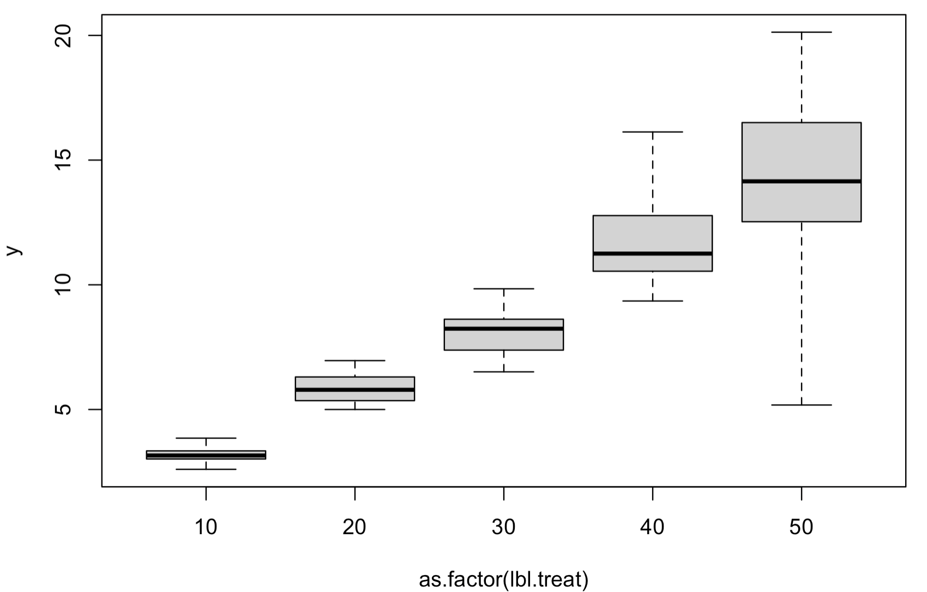
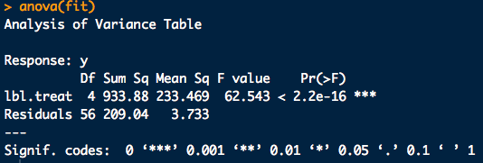
Example

Slide 18
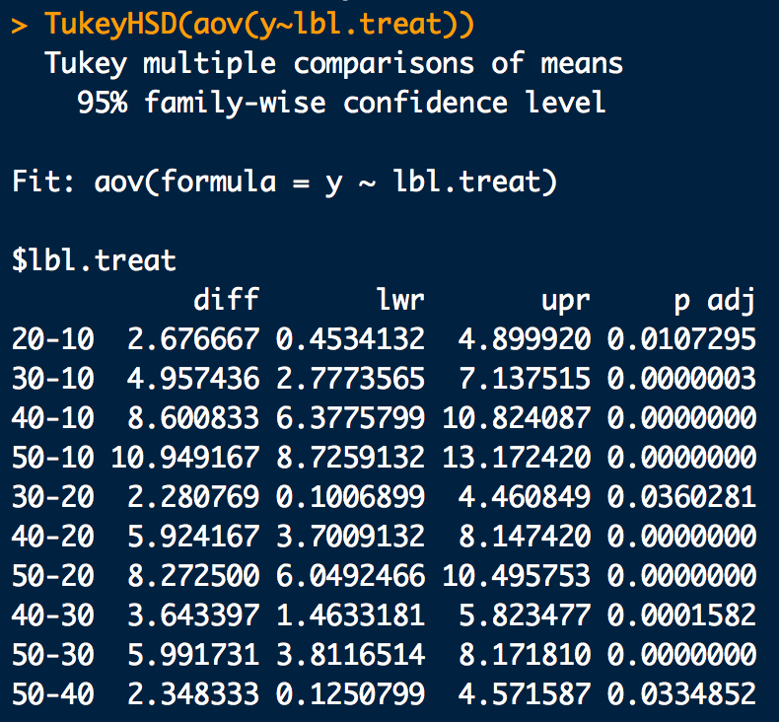
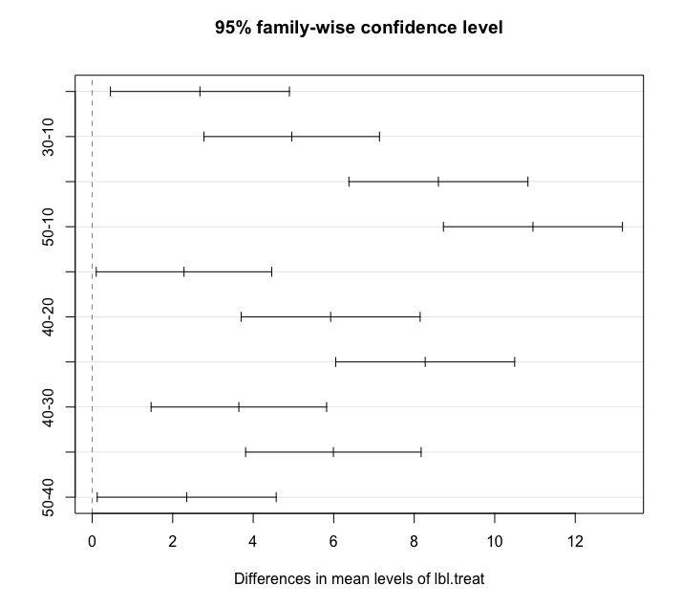
Another Tukey HSD Example
# Find a significant result from ANOVA? Do a Tukey HSD:
fit.tukey <- TukeyHSD(fit)
fit.tukey # Tukey test outputs
plot(fit.tukey) # Graphical version

Slide 19
Basic Linear Regression
y
x

Slide 20
Example: Basic Linear Regression
Consider the Manganese and Zirconium content for sets of different kinds of glass bottles^{Curran}
Manganese Data (Mn)
56.1, 53.8, 58.7, 54.6, 58.6, 56.8, 54.6, 59.2, 54.9, 61.1, 59.4, 54.9, 58.7, 55.3, 61.7, 59.7, 56.3, 59.8, 53.6, 60.6,
58.6, 52.5, 61.2, 54, 61.7, 59, 53.9, 61.5, 57.4, 60.5, 65.8, 55, 60.8, 56.4, 63.4, 65.4, 55.9, 59.7, 56.9, 63.4,
65.2, 55.1, 61.6, 58.7, 63.8, 64.7, 56.6, 60.9, 57.8, 63.5, 64.1, 57.4, 61.2, 57.4, 65, 64.8, 56.7, 60.3, 57.6, 64.3,
66, 57.5, 61.5, 58, 65.3, 67.2, 56.3, 60.3, 57.4, 66.4, 67.9, 55.2, 63, 58, 65.2, 66.1, 57.7, 63.3, 58.7, 64,
52.7, 43.5, 49.8, 47, 52.1, 50.2, 41.8, 48.6, 44.9, 51.1, 50.8, 45.2, 49, 44.6, 50.9, 52.3, 43.3, 48.8, 45.5, 52,
65.1, 57.4, 64.5, 59.3, 66.5, 66.6, 56.8, 62.6, 59, 67.8, 65.7, 56.6, 62.4, 57.9, 67.2, 64.9, 52.4, 61.9, 57.8, 63.9
Zirconium Data (Zr)
77.4, 71.6, 78.2, 75.3, 83.9, 79.2, 74.6, 78.9, 80.2, 90.2, 77.6, 70.3, 74.7, 72.4, 83.4, 78.3, 71.4, 79.4, 78.0, 82.7,
85.8, 80.0, 90.8, 88.0, 99.2, 85.1, 70.3, 80.0, 77.7, 84.8, 86.3, 70.2, 80.6, 79.9, 86.8, 84.5, 71.4, 79.6, 78.4, 86.8,
93.3, 81.4, 91.4, 86.5, 99.0, 100.9, 88.0, 95.1, 94.4, 109.4, 89.5, 79.3, 87.1, 85.3, 98.5, 100.4, 83.7, 89.5, 93.8, 106.7,
102.6, 85.9, 91.7, 93.4, 109.4, 111.4, 93.4, 101.1, 103.6, 118.7, 92.9, 77.1, 84.1, 84.0, 100.1, 97.5, 82.9, 94.6, 91.4, 102.2,
63.1, 51.2, 59.1, 57.0, 65.6, 74.0, 60.1, 70.9, 68.8, 79.8, 56.6, 50.0, 58.3, 56.2, 69.5, 67.3, 55.6, 64.2, 63.9, 75.4,
101.5, 84.0, 96.5, 91.0, 109.6, 81.4, 70.6, 81.1, 79.7, 91.0, 116.6, 94.2, 109.8, 108.5, 125.7, 81.5, 67.8, 80.8, 77.9, 90.9

Slide 21
Example: Basic Linear Regression
Compute a best fit line to the data of Mn vs Zr and report:
a. The slope coefficient,
b. The intercept coefficient,
c. Is the slope coefficient significant at, at least the 95% level of confidence?
d. Is the intercept coefficient significant at, at least the 95% level of confidence?
e. The standard error of the residuals,
f. The Adjusted R-squared correlation coefficient

Slide 22
Example: Basic Linear Regression
# Load the data Mn = x, Zr = y:
x <- c(
56.1, 53.8, 58.7, 54.6, 58.6, 56.8, 54.6, 59.2, 54.9, 61.1,
59.4, 54.9, 58.7, 55.3, 61.7, 59.7, 56.3, 59.8, 53.6, 60.6,
58.6, 52.5, 61.2, 54, 61.7, 59, 53.9, 61.5, 57.4, 60.5,
65.8, 55, 60.8, 56.4, 63.4, 65.4, 55.9, 59.7, 56.9, 63.4,
65.2, 55.1, 61.6, 58.7, 63.8, 64.7, 56.6, 60.9, 57.8, 63.5,
64.1, 57.4, 61.2, 57.4, 65, 64.8, 56.7, 60.3, 57.6, 64.3,
66, 57.5, 61.5, 58, 65.3, 67.2, 56.3, 60.3, 57.4, 66.4,
67.9, 55.2, 63, 58, 65.2, 66.1, 57.7, 63.3, 58.7, 64,
52.7, 43.5, 49.8, 47, 52.1, 50.2, 41.8, 48.6, 44.9, 51.1,
50.8, 45.2, 49, 44.6, 50.9, 52.3, 43.3, 48.8, 45.5, 52,
65.1, 57.4, 64.5, 59.3, 66.5, 66.6, 56.8, 62.6, 59, 67.8,
65.7, 56.6, 62.4, 57.9, 67.2, 64.9, 52.4, 61.9, 57.8, 63.9
)
y <- c(
77.4, 71.6, 78.2, 75.3, 83.9, 79.2, 74.6, 78.9, 80.2, 90.2,
77.6, 70.3, 74.7, 72.4, 83.4, 78.3, 71.4, 79.4, 78.0, 82.7,
85.8, 80.0, 90.8, 88.0, 99.2, 85.1, 70.3, 80.0, 77.7, 84.8,
86.3, 70.2, 80.6, 79.9, 86.8, 84.5, 71.4, 79.6, 78.4, 86.8,
93.3, 81.4, 91.4, 86.5, 99.0, 100.9, 88.0, 95.1, 94.4, 109.4,
89.5, 79.3, 87.1, 85.3, 98.5, 100.4, 83.7, 89.5, 93.8, 106.7,
102.6, 85.9, 91.7, 93.4, 109.4, 111.4, 93.4, 101.1, 103.6, 118.7,
92.9, 77.1, 84.1, 84.0, 100.1, 97.5, 82.9, 94.6, 91.4, 102.2,
63.1, 51.2, 59.1, 57.0, 65.6, 74.0, 60.1, 70.9, 68.8, 79.8,
56.6, 50.0, 58.3, 56.2, 69.5, 67.3, 55.6, 64.2, 63.9, 75.4,
101.5, 84.0, 96.5, 91.0, 109.6, 81.4, 70.6, 81.1, 79.7, 91.0,
116.6, 94.2, 109.8, 108.5, 125.7, 81.5, 67.8, 80.8, 77.9, 90.9
)

Slide 23
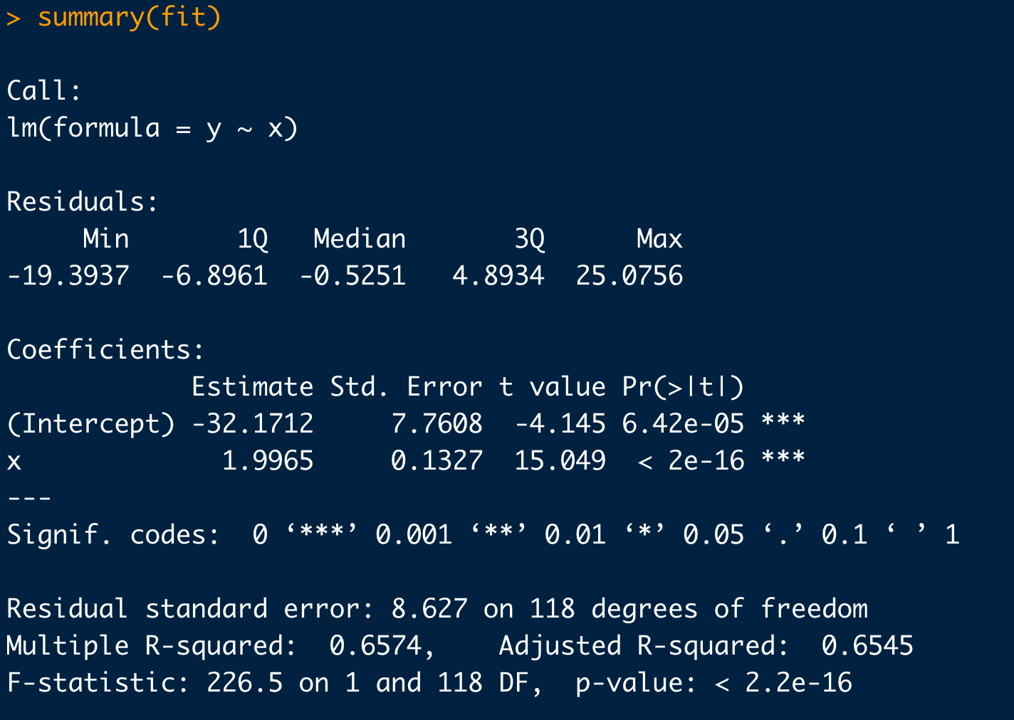
Example: Basic Linear Regression
# Take a look at your data first:
plot(x,y)
# Simple linear regression:
fit <- lm(y ~ x)
summary(fit)
# Plot in your regression line:
plot(x,y)
abline(fit)
slope is significant at 95%
intercept is significant at 95%
Adjusted R²

